Slide 1
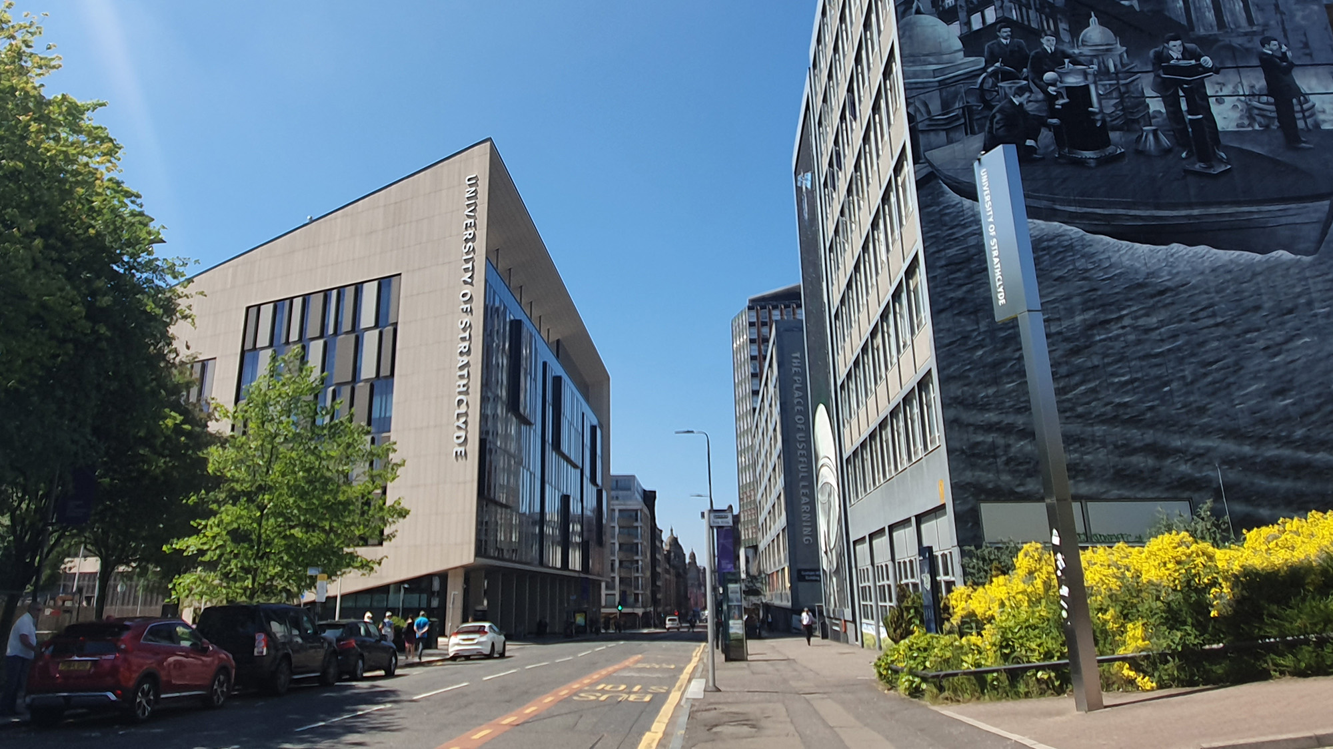

Digital filters
Digital Filters Design:
Introduction
carmine.clemente@strath.ac.uk

Slide 2
Advantages of Digital Filters
Characteristics that are not possible with analog filters;
Performance is independent of environmental changes;
Filters can be made adaptive;
Filters can be multiplexed;
Stopband attenuation for analog filters has a maximum of 60-70dBs whereas with digital filters this is limited by the wordlength used;
Performance is repeatable;
Digital Filters can operate at very low frequencies like those encountered in biomedicine.

Slide 3
Disadvantages of Digital Filters
Speed Limitation: Speed of operation of a digital filter depends on the speed of the processor;
Finite wordlength: Digital Filters are subject to ADC noise resulting from quantizing a continuous signal and also to roundoff errors incurred during computation. These can lead to instability or imprecise design specifications being met;
Longer design times required for Digital Filters.

Slide 4
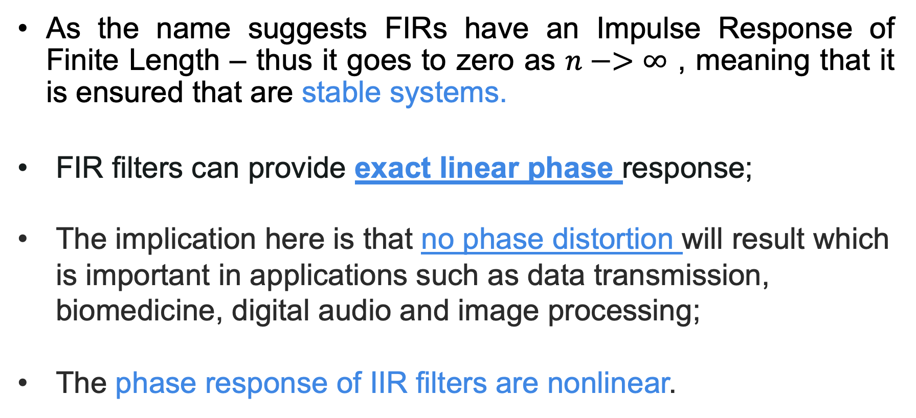
Finite Impulse Response and Infinite Impulse Response Filters
As the name suggests FIRs have an Impulse Response of Finite Length – thus it goes to zero as $n−>∞$ , meaning that it is ensured that are stable systems.
FIR filters can provide exact linear phase response;
The implication here is that no phase distortion will result which is important in applications such as data transmission, biomedicine, digital audio and image processing;
The phase response of IIR filters are nonlinear.

Slide 5
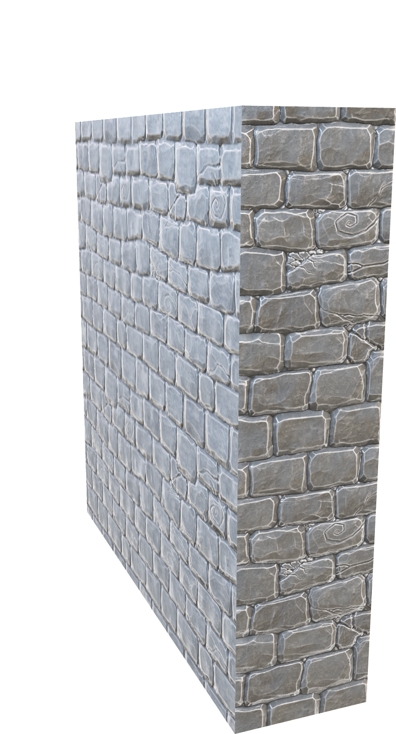



Phase Distortion and Group Delay
Let us try to understand why we might want that a filter has linear phase (no phase distortion).
The 3 marbles (3 frequencies) hit the wall at the same time: NO DISTORTION, SAME GROUP DELAY

Slide 6
Phase Distortion and Group Delay
The 3 marbles (3 frequencies) hit the wall at different times: Phase DISTORTION, Different GROUP DELAY

Slide 7
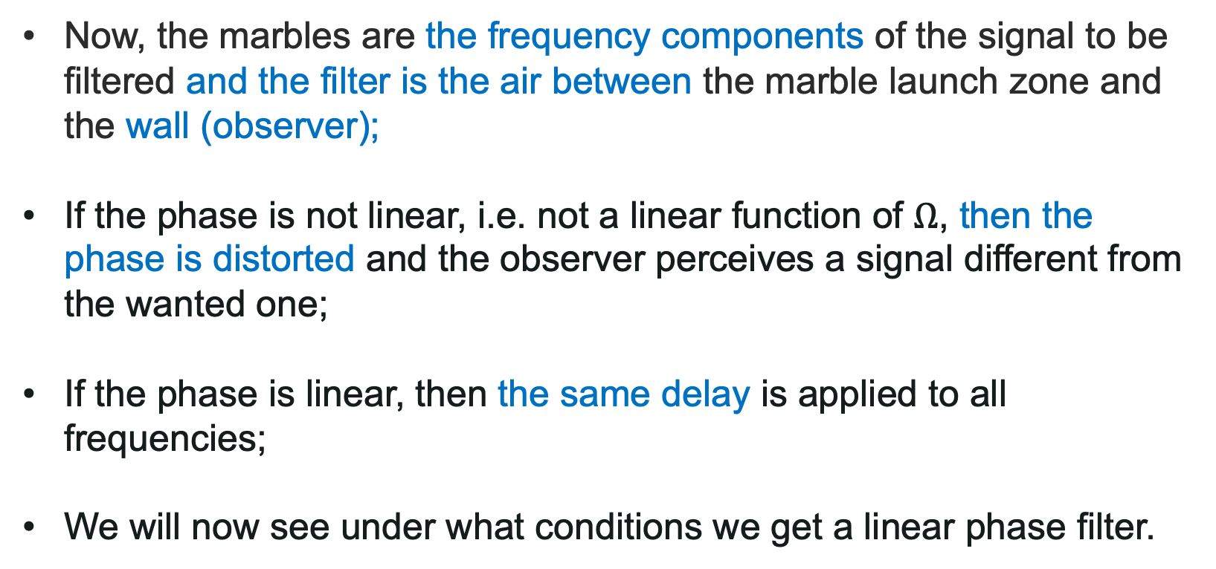
Phase Distortion and Group Delay
Now, the marbles are the frequency components of the signal to be filtered and the filter is the air between the marble launch zone and the wall (observer);
If the phase is not linear, i.e. not a linear function of $Ω$, then the phase is distorted and the observer perceives a signal different from the wanted one;
If the phase is linear, then the same delay is applied to all frequencies;
We will now see under what conditions we get a linear phase filter.

Slide 8
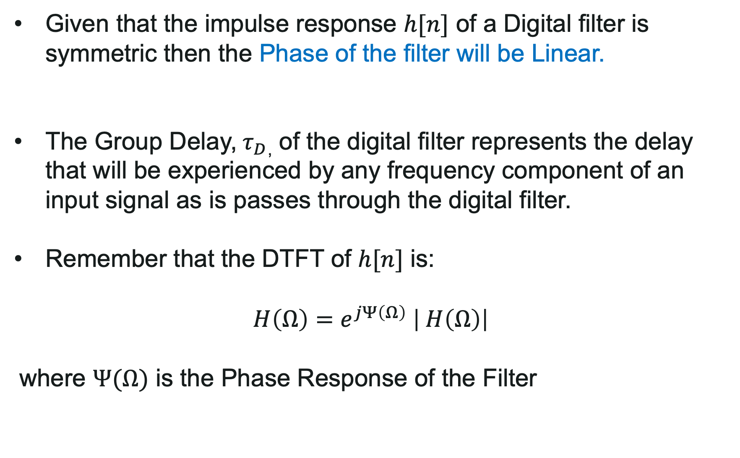
Linear Phase Digital Filters
Given that the impulse response $h[n]$ of a Digital filter is symmetric then the Phase of the filter will be Linear.
The Group Delay,${ τ}_{D}$, of the digital filter represents the delay that will be experienced by any frequency component of an input signal as is passes through the digital filter.
Remember that the DTFT of $h[n]$ is:
$$H\left(Ω\right)=e^{jΨ\left(Ω\right)} \left| H\left(Ω\right)\right|$$
where $Ψ(Ω)$ is the Phase Response of the Filter

Slide 9
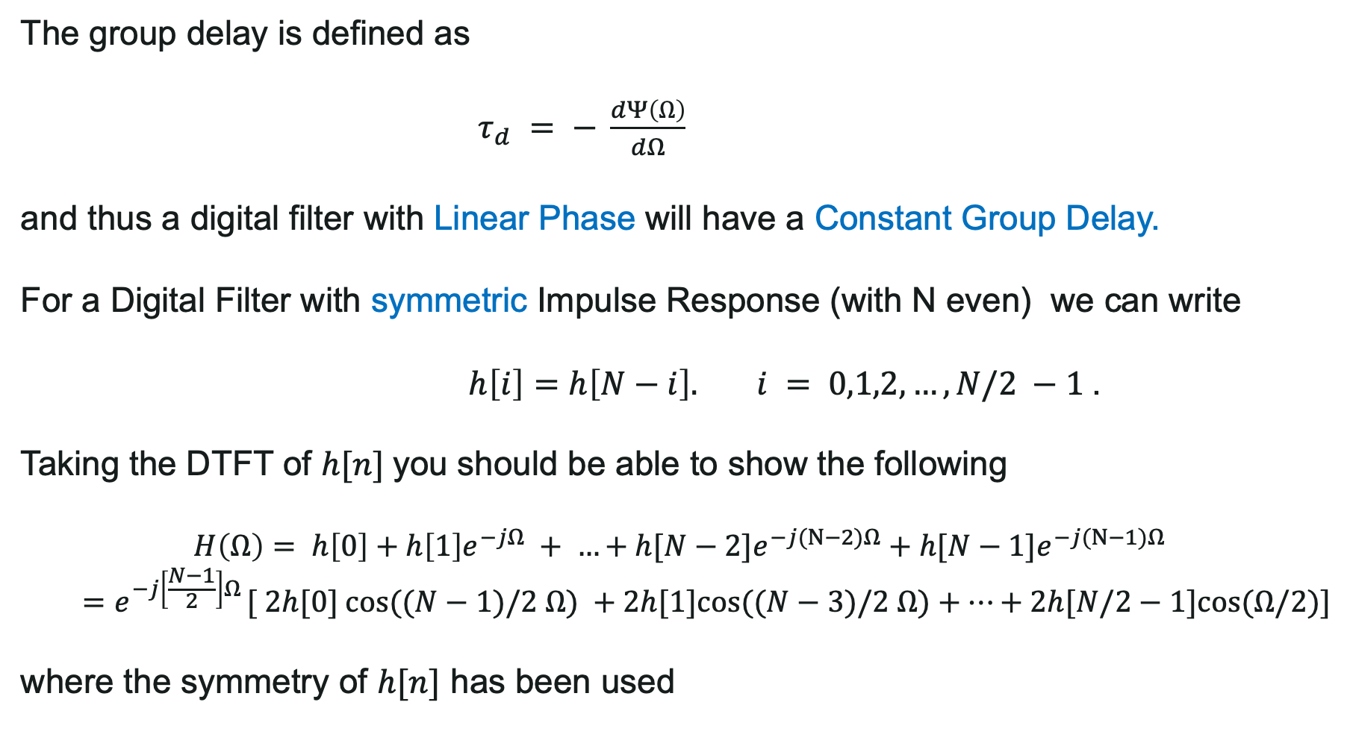
Linear Phase Digital Filters
The group delay is defined as
$τ_{d} = − \frac{dΨ\left(Ω\right)}{dΩ}$
and thus a digital filter with Linear Phase will have a Constant Group Delay.
For a Digital Filter with symmetric Impulse Response (with N even) we can write
$h\left[i\right]=h\left[N−i\right]. i = 0,1,2,…,N/2 −1$.
Taking the DTFT of $h[n]$you should be able to show the following
$$H\left(Ω\right)= h\left[0\right]+h\left[1\right]e^{−jΩ} + …+h[N−2]e^{−j(N−2)Ω}+h[N−1]e^{−j(N−1)Ω}$$
$$=e^{−j\left[\frac{N−1}{2}\right]Ω} [ 2h[0] cos⁡((N−1)/2 Ω) +2h[1]cos⁡((N−3)/2 Ω)+…+2h[N/2−1]cos⁡(Ω/2)]$$
where the symmetry of $h[n]$ has been used

Slide 10
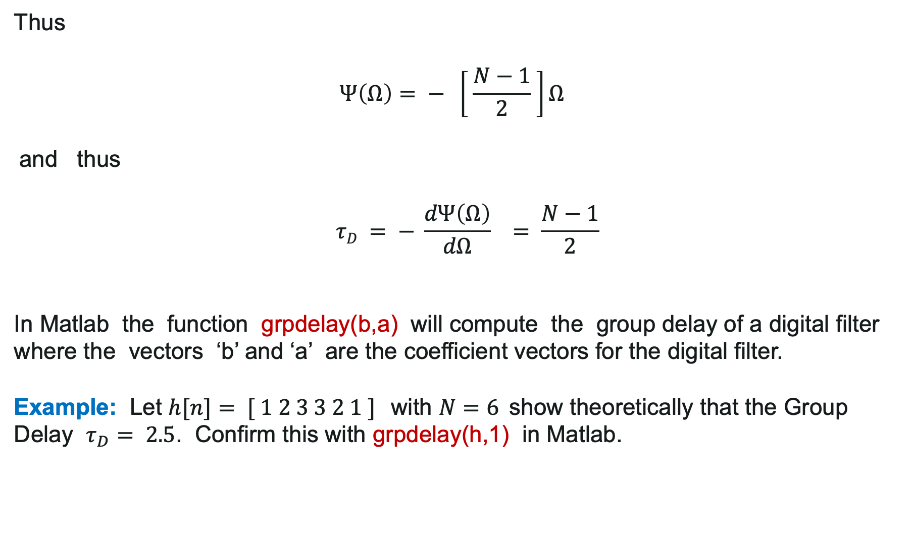
Linear Phase Digital Filters
Thus
$$Ψ\left(Ω\right)= − \left[ \frac{N−1}{2} \right]Ω$$
and thus
$$τD = − \frac{dΨ\left(Ω\right)}{dΩ} = \frac{N−1}{2}$$
In Matlab the function grpdelay(b,a) will compute the group delay of a digital filter where the vectors ‘b’ and ‘a’ are the coefficient vectors for the digital filter.
Example: Let $h[n]= [ 1 2 3 3 2 1 ]$with $N=6$show theoretically that the Group Delay $τ_{D}= 2.5$. Confirm this with grpdelay(h,1) in Matlab.

Slide 11
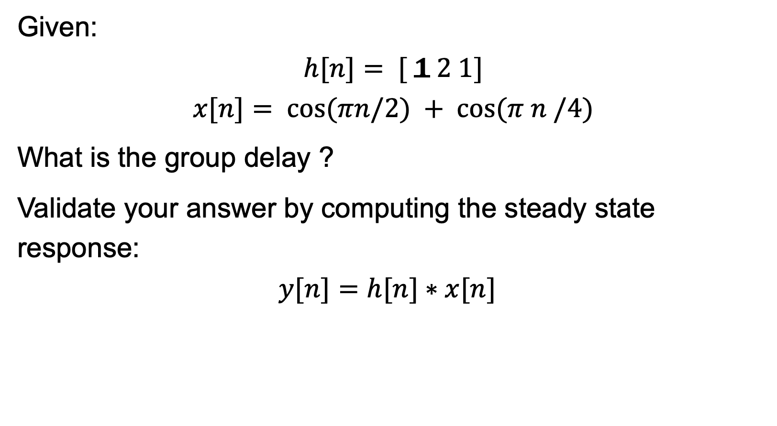
Linear Phase Example
Given:
$$h[n]= [ 1 2 1]$$
$$x[n]= cos⁡(πn/2) + cos⁡(π n /4)$$
What is the group delay ?
Validate your answer by computing the steady state response:
$$y[n]=h[n]∗x[n]$$

Slide 12
Selection between FIR and IIR
FIR filters provide exact linear phase response providing the impulse response is SYMMETRIC.
The implication here is that no phase distortion will result which is important in applications such as data transmission, biomedicine, digital audio and image processing. The phase response of IIR filters are nonlinear.
Non-recursive FIR designs are stable. IIR cannot be guaranteed to be stable.
The effects of using quantised coefficients is much less severe in FIRs than IIR.
FIR require more coefficients than IIR to produce sharp cutoff. Techniques such as multirate methods improves this situation.
Analog filters can be easily transformed into IIRs. This is not possible with FIRs as they have no analog counterpart.

Slide 13
Selection between FIR and IIR
Use IIR when sharp cut off and high throughput are the only main requirements.
Use FIR if little or NO phase distortion is acceptable. Also newer DSP hardware have architectures that are tailored to FIR filtering.

Slide 14
Digital Filters Realization
Starting from the linear difference equation it is useful to learn how to draw the Realization or Structure of the filter;
The Realization is a block diagram describing the “algorithm” implemented by the filter and is useful to:
Be translated in a software implementing the filter or
Be translated in hardware implementing the filter.

Slide 15
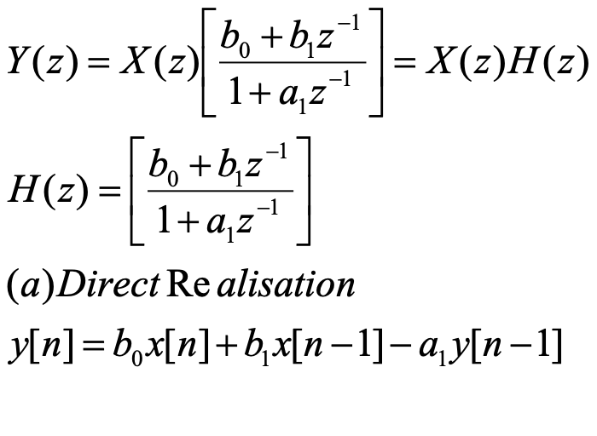
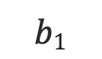
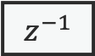
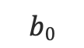
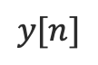
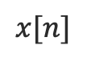
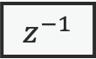
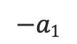
DF Realization: Direct-Form
Let us consider the filter with linear difference equation
$$x[n]$$
$$z^{−1}$$
$$z^{−1}$$
$$b0$$
X
X
X
$$b1$$
$$−a1$$
$$y[n]$$
+
+

Slide 16
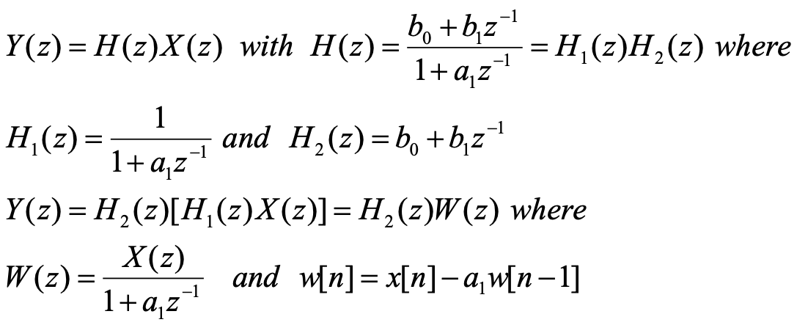
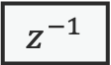
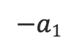
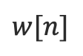
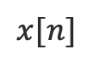
DF Realization
We might want to try to reduce the number of required components
$$x[n]$$
+
$$−a1$$
X
$$w[n]$$
$$z^{−1}$$

Slide 17
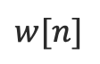
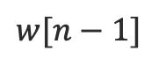
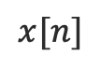
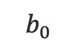
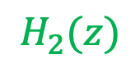
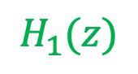
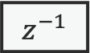
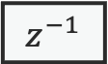
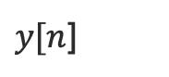
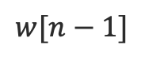
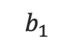
DF Realization
$$H_{1}(z)$$
$$H_{2}(z)$$
$$x[n]$$
+
+
$y[n$]
$$b_{0}$$
X
$$b_{1}$$
X
$$−a1$$
X
$$w[n]$$
$$w[n−1]$$
$$w[n−1]$$
$$z^{−1}$$
$$z^{−1}$$

Slide 18

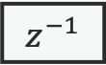
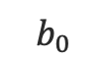
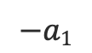
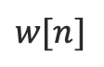
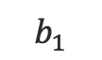
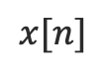

DF Realization
Now we can rearrange (fold) the realization in order to save in complexity
$$x[n]$$
+
Canonical Realization of 1st order digital filter
$$−a1$$
X
$$w[n]$$
$$z^{−1}$$
$$w[n−1]$$
Only 1 delay required
$$b_{1}$$
X
$$b_{0}$$
X
+
$y[n$]

Slide 19
Classes of Digital filters
Class 1: Nonrecursive (Finite Impulse Response)
Sometimes called a Transversal Filter or Tapped Delay Line
Exercise:
What is h[n]?
FIR is STABLE why ?
Draw its realisation

Slide 20
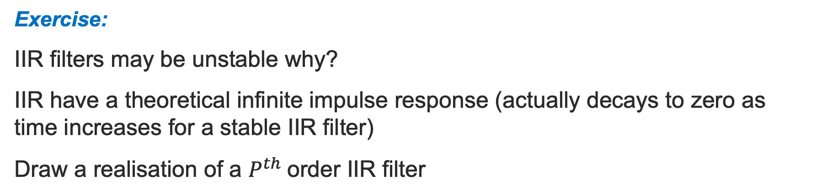
Classes of Digital filters
Class 2: Recursive (Infinite Impulse Response)
Exercise:
IIR filters may be unstable why?
IIR have a theoretical infinite impulse response (actually decays to zero as time increases for a stable IIR filter)
Draw a realisation of a $P^{th}$order IIR filter

Slide 21
Classes of Digital filters
Class 3: General Digital Filter
Exercise:
Realise a general digital filter in a canonical form for P=Q=4

Slide 22
Digital Filter Design Steps
Not all required in every design
Specification of the filter requirements;
Calculation of suitable filter coefficients;
Representation of the filter by a suitable structure (realization);
Analysis of the effects of finite wordlength on the filter performance;
Implementation of the filter in software and/or hardware.

Slide 23
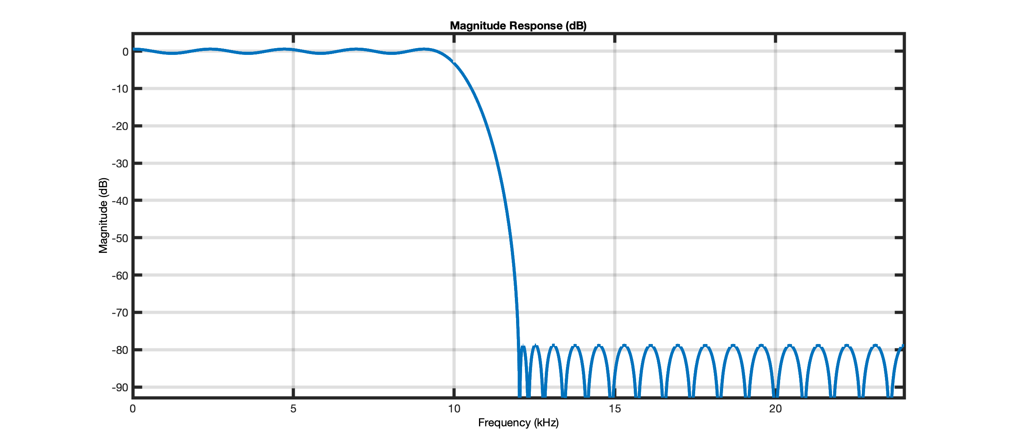
Specifications
Maximum Passband Ripple
Transition Bandwidth
Stopband
Passband

Slide 24
Finite Wordlength Effect
The main sources of performance degradation in digital filters include:
Input/output signal quantisation
Coefficient quantisation
Arithmetic roundoff errors
Overflow

Slide 25
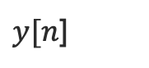
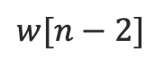
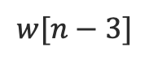

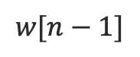
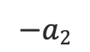
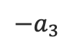
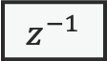
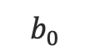

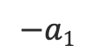
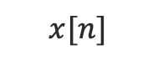





Example: Canonical Realization for P = Q = 3;
$$x[n]$$
+
+
+
$$−a_{3}$$
X
$$−a2$$
X
$$−a1$$
X
$$−a_{0}=1$$
$$z^{−1}$$
$$z^{−1}$$
$$z^{−1}$$
$$w[n]$$
$$w[n−3]$$
$$w[n−1]$$
$$w[n−2]$$
$$b_{3}$$
X
$$b_{2}$$
X
$$b_{1}$$
X
$$b_{0}$$
X
+
+
+
$y[n$]

